Slide 1
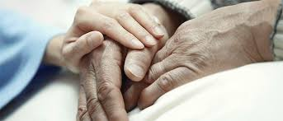


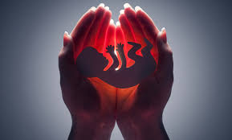
Life and Death: Ethical Controversies
EUTHANASIA
ABORTION

Slide 2

Bioethics (medical ethics): moral issues of life and death
Examples:
abortion*
euthanasia (and physician-assisted suicide)*,
stem cell research,
cloning,
surrogate pregnancy and
eugenics,
etc. * Today’s topics

Slide 3
Controversies on life and death
‘Controversies’ means prolonged public disagreements and heated discussions.
Ethical controversies are divisive, and often hotly disputed at the social level.
Regarding controversial ethical issues, arguably it is the issues of life and death that are the most disagreed upon and fiercely debated.
Why?
Life (existence) vs. Happiness
Quality of
life
Autonomy

Slide 4
Moral dilemma
Logical form:
Either A or B.
If A, then R.
If B, then S.
Therefore, either R or S.
Either (A) carrying the fetus or (B) aborting the fetus.
If (A) carrying the fetus, then (R) the pregnant woman’s health would be worsened.
If (B) aborting the fetus, then (S) we will lose a life (unborn baby).
Therefore, either (R) the pregnant woman’s health would be worsened or (S) we will lose a life (unborn baby).

Slide 5
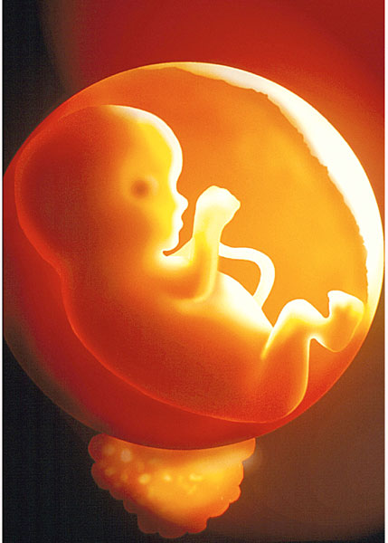
‘Abortion’: its meaning
The termination of a fetus (or foetus) before the pregnancy is carried to term.
intended, with a purpose, and a medical procedure
unlike miscarriage (which is natural and spontaneous)
‘Fetus’ —
Broad sense
All phases of development before birth
Narrow sense
(Different from zygote and embryo) a ‘fetus’ refers to the stage from 8 weeks onwards, when the organs are grown. to form.

Slide 6
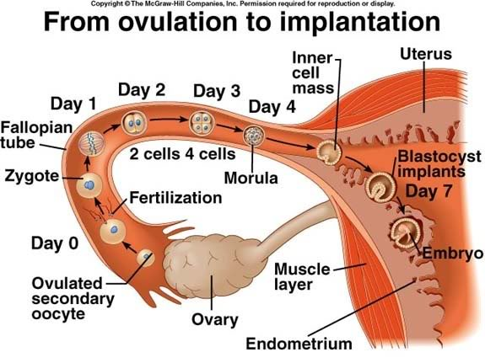

Slide 7
Two opposite views
‘Pro-life’
Not allowing abortion
‘Pro-choice’
Allowing abortion
Note: Some people hold a middle view.

Slide 8
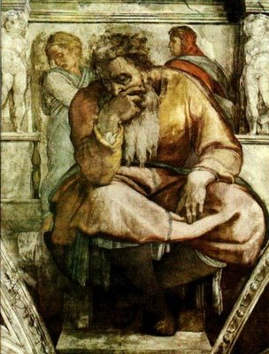
Early Pro-Life Quotes
‘Now the word of the Lord came to me saying, “Before I formed you in the womb I knew you, and before you were born I consecrated you: I appointed you a prophet of nations.”’
Jeremiah – 1:5
What is the relevance here?

Slide 9
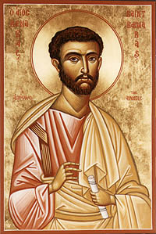
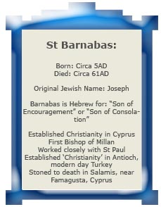
Early Pro-life quotes
‘You shall not procure [an] abortion, nor destroy a newborn child.’
Letter of Barnabas

Slide 10
What are the pro-life arguments?
Sanctity of life
This is the moral principle that the life of a fetus is sacred and that this life must not be taken away.
The fetus is innocent and has a right to life.
Against the doctor’s Hippocratic oath [stating the obligations and proper conduct of doctors] – including Non-maleficence (“First do no harm.”)

Slide 11
If we allow abortion, then:
other problems will come such as the following:
selective breeding in population control,
casual sex outside of marriage, etc.
Caution: No. 3 is a kind of slippery-slope or landslide argument.

Slide 12
A slippery-slope argument
It says “if we let A happen, B is likely to happen, too, and if B happens, then C would also happen, if C happens, then D will happen, too; as D is obviously bad, we must not do A”.
The problem with this is that it is not necessary that B (C, D) would happen, and that it is possible that we can avoid B from A through, in particular, laws and education.

Slide 13
A religious pro-life argument
Premise 1 What God forbids is always wrong.
Premise 2 God forbids the killing of anything with a
soul.
Premise 3 All unborn children have souls.
Premise 4 God forbids abortion.
Premise 5 Abortion involves the killing of unborn
children (who have souls).
-----------------------------------------------------------------
CONCLUSION Abortion is always wrong.
Disagreements

Slide 14
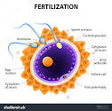
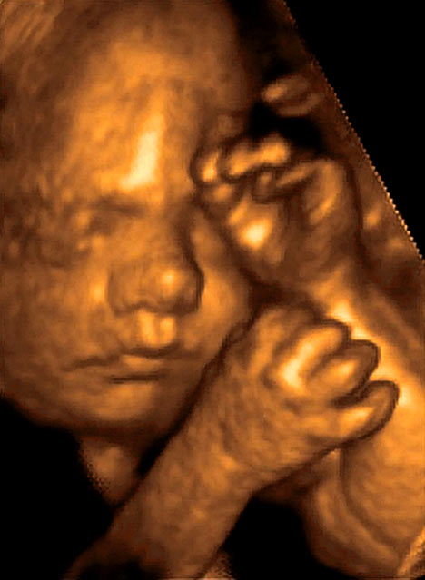
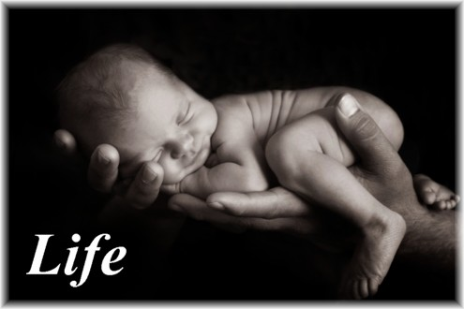
When does a person’s life start?
At conception (when the ovum is fertilized)?
‘The Quickening’ (ranging from 13 to 25 weeks, when ancients believed the soul enters the fetus; when the pregnant woman starts to feel or perceive fetal movements in the uterus [womb])?
After 24 weeks (‘Fetal viability’: A fetus can survive using medical devices instead of depending on its mother’s body)?
At birth?

Slide 15
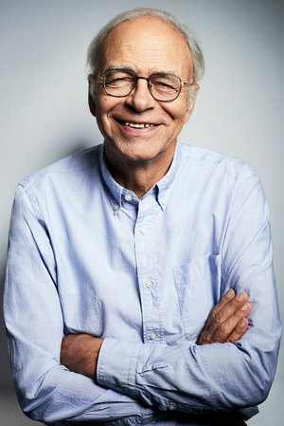
AGAINST Pro-life: “… Since no fetus is a person, no fetus has the same claim to life as a person.” – Peter Singer
Premise 1: A person is given rights because of their capacities of reasoning, self-awareness, moral autonomy and having certain pleasures or pains.
Premise 2: A human fetus does not possess such capacities.
------------------------------------------------------------------
Conclusion: A fetus does not possess the same rights as a person.

Slide 16
A rebuttal to Singer’s point
A fetus is a ‘potential’ human being.
Although now it is not able to think reasonably and choose, it can in the future.
So it is an entity that we should treasure and protect.
Do you think whether a potential human being has human rights?

Slide 17
Pro-life stance – Main points
The fetus is a human person at the time of conception; killing an innocent human being is wrong.
A fetus is entitled to fundamental human rights (the right to life); we must protect it.
A human life is sacred; it should not be harmed.
The state could override a woman’s decision to have an abortion and require her to continue her pregnancy to childbirth.

Slide 18
The pro-freedom/choice argument
The State should not interfere a woman’s decision on abortion.
Reasons:
The fetus is within a woman’s body until it is born, and the woman should have the right over her own body (that is, to determining the affairs concerning her body).
The decision of whether to give birth to a child should be seen in terms of the overall situation in which a woman finds herself.

Slide 19
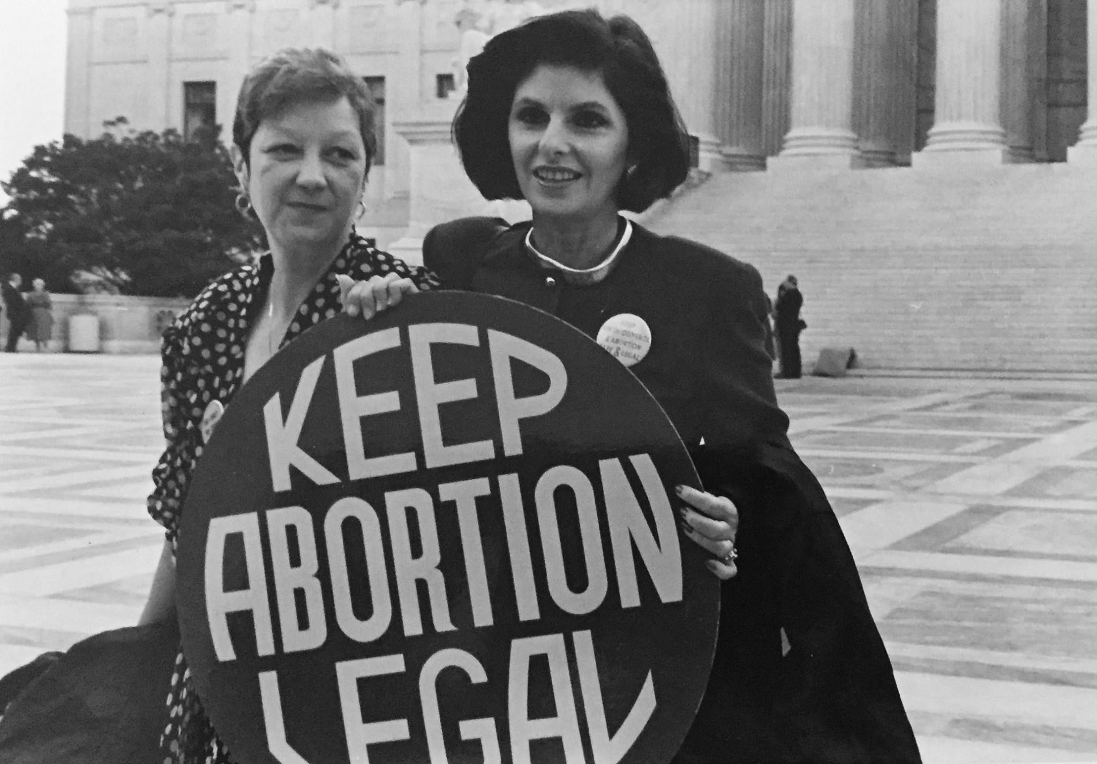
Norma McCorvey
(Jane Roe)

Slide 20
Roe versus Wade (1973)
The ruling came after a 25-year-old single woman, Norma McCorvey under the pseudonym ‘Jane Roe’, challenged the criminal abortion law in Texas as unconstitutional.
That law forbade abortion except in cases where the mother’s life was in danger.
This led to a great debate on abortion in the US and has divided the Americans into pro-lifers and pro-choicers.

Slide 21
In 1995, McCorvey became an anti-abortion activist.
Norma McCorvey: ‘It was my pseudonym, Jane Roe, which had been used to create the “right” to abortion out of legal thin air [= from nothing]. But Sarah Weddington and Linda Coffee never told me that what I was signing would allow women to come up to me 15, 20 years later and say, “Thank you for allowing me to have my five or six abortions. Without you, it wouldn’t have been possible.” Sarah never mentioned women using abortions as a form of birth control. We talked about truly desperate and needy women, not women already wearing maternity clothes.’
https://en.wikipedia.org/wiki/Roe_v._Wade#Activities_of_Norma_McCorvey

Slide 22
Does a choice matter?
Consider these situations (among others):
Severe disabilities (mother or the potential child)
Deformed fetus
Instances of rape or incest
To be born into an abusive household
Extreme poverty
...

Slide 23
Abortion law Fiji
234.—(1) A person commits an indictable offence if he or she unlawfully performs an abortion.
Penalty — Imprisonment for 14 years.
But under what conditions is abortion allowed in Fiji?
235. A woman commits a summary offence if she, being pregnant, with intent to procure her own miscarriage—
Penalty — Imprisonment for 7 years.
See: https://www.womenonwaves.org/en/page/5187/abortion-law-fiji

Slide 24
Utilitarianism on abortion
Option 1: aborting a fetus
Option 2: not aborting the fetus
Which option can maximise the happiness and minimise the pain and suffering for the greatest number of people?
Do the Utilitarians consider the context, like the Virtue Ethicists?
In which contexts would option 1 more likely fulfil the utilitarian principle?

Slide 25
Deontology on abortion
When a pregnant woman aborts a fetus, does she treat the fetus as an end or as a means?
When a pregnant woman decides whether she should abort her fetus, what obligations has she to consider and fulfil?

Slide 26
Euthanasia
Originated from the Greek word ‘Euthanatos’
‘eu’ = good, happiness
‘thanatos’ = death
‘Euthanatos’ originally = good dying, good death and death without pain
In the West, from Ancient Greece to the 18th Centuries, euthanasia was understood as:
good and peaceful dying, and also
natural and comfortable death.

Slide 27
After the industrial revolution (roughly after 1850), ‘euthanasia’ has had a new (more positive) meaning:
A patient’s death can be accelerated and brought about by advanced medical means, so that he or she need not suffer too much.
More active (because it can be initiated by the patient or doctor)
Synonyms: ‘Death with dignity’, and ‘mercy killing’, etc.

Slide 28
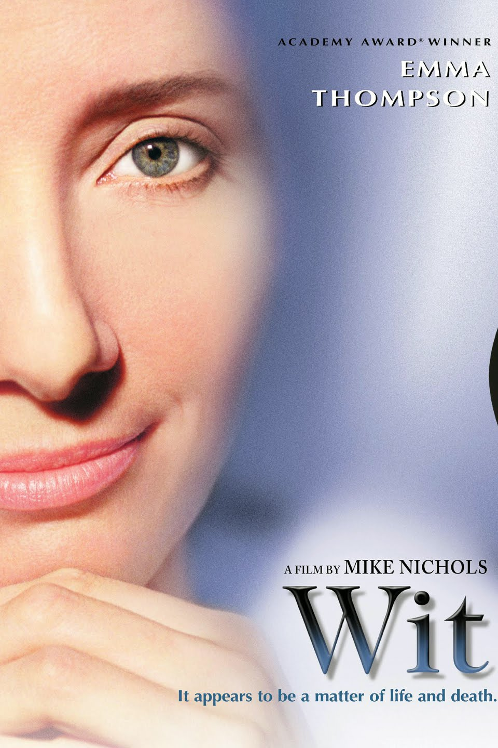

Slide 29
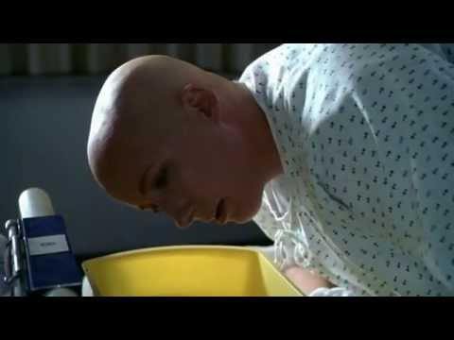

Slide 30
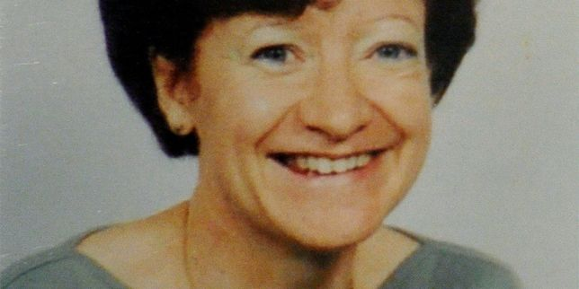
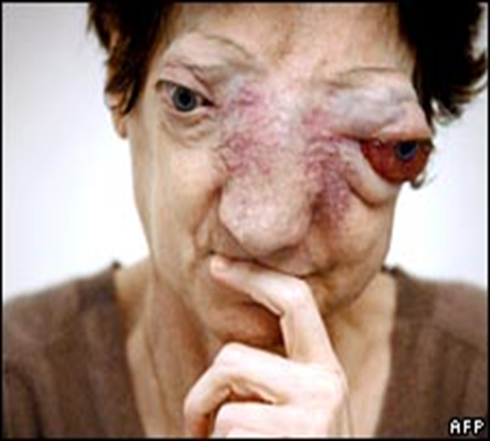
Chantal Sebire (1955-2008)
Having a rare form of cancer – a facial tumor, she wanted to terminate her life with the help of physicians.
Do you think she has a right to euthanasia?

Slide 31
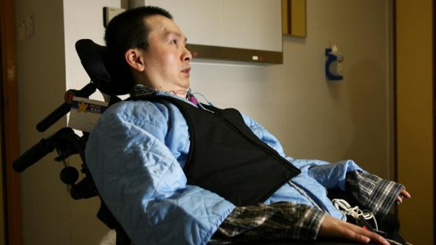

Slide 32
Tang Siu-pun (1969 - 2012)
Tang [Siu-pun], better known as Ah Bun, who died in 2012 at age 43, was practising for a gymnastics event in 1991 when he fell badly and injured his spine. The accident left him paralyzed from the neck down.
In 2003, using a stick held in his mouth to type, he made an appeal to then Chief Executive [of Hong Kong] Tung Chee-hwa, asking for euthanasia to be legalized.
‘Time has become meaningless for me. I look at the clock ticking second after second every single day and what am I waiting for? It's just the moment when death comes,’ he wrote in the letter.
http://www.scmp.com/news/hong-kong/article/1101608/tang-siu-pun-small-measure-happiness-after-years-despair

Slide 33
Types of Euthanasia (1)
Voluntary euthanasia
When the patient freely chooses to die at the time of the illness or by signing a ‘living will’ before (giving consent)
Involuntary euthanasia
Not willing to terminate their life
E.g. the Jews during the second world war
Non-voluntary euthanasia
Some patients with euthanasia do not have the capacity to have any intention.
Such as babies, patients in a persistent vegetative state, patients who have lost the thinking abilities, and so on.

Slide 34
Physician-assisted suicide
‘Physician-assisted suicide is often confused with euthanasia.
In cases of euthanasia the physician administers the means of death, usually a lethal drug.
In physician-assisted suicide (PAS), it is required that the person voluntarily expresses his or her wish to die, and also makes a request for medication for the purpose of ending his or her life.
Physician-assisted suicide thus involves a person’s self-administration of deadly drugs that are supplied by a doctor.’
https://en.wikipedia.org/wiki/Assisted_suicide

Slide 35
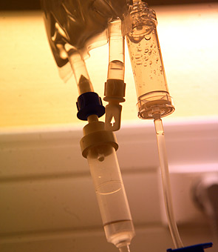

Types of Euthanasia (2)
Active euthanasia
E.g., a lethal injection is administered by a physician to end a patient’s lifelife
Passive euthanasia
Withholding or withdrawing life-sustaining treatment, (nutrition, medication, respirator) - allowing death to occur, letting nature take its course)

Slide 36
What kind(s) of euthanasia is (are) more acceptable to you?
Voluntary and active euthanasia
Voluntary and passive euthanasia
Involuntary and active euthanasia
Involuntary and passive euthanasia
Non-voluntary and active euthanasia
Non-voluntary and passive euthanasia

Slide 37
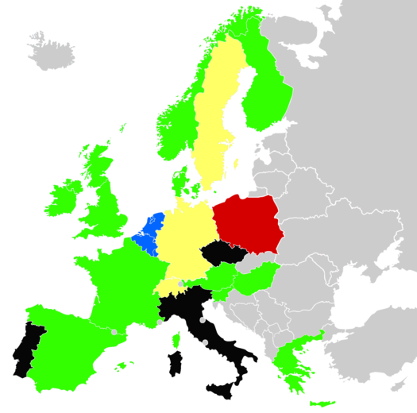

Slide 38
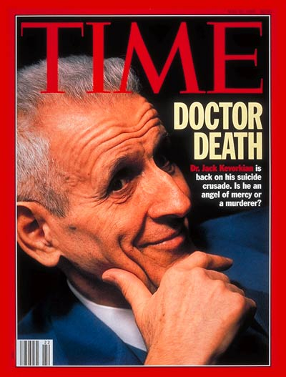
Dilemma
Dr. Jack Kervokian (American Pathologist) claims to have assisted at least 130 patients to that end.
He famously said that "dying is not a crime."
Between 1999 and 2007, Kevorkian served eight years of a 10-to-25-year prison sentence for second-degree murder. He was released on parole on June 1, 2006, due to good behavior.

Slide 39
Arguments FOR euthanasia
Choice (autonomy): freedom/right to choose whether to go on living
Quality of life: poor quality – physical and mental pain, and suffering, no dignity
Economic costs & human resources: shortage of hospital beds & staff – burden to keep terminally ill patients alive, better to use these resources for curable aliments

Slide 40
Some countries practice euthanasia under certain conditions
Patients with euthanasia are terminal patients.
These patients’ physical condition can hardly recover within their remaining span of life.
They persistently suffer from unbearable pain and unacceptable burden.
They are able to deliberate whether to terminate their life and able to desire life or death, and they have a firm and voluntary intention to die. Or, before they lose their communicative abilities, they write down their ‘Living will’ (advance decision).
Without the help of others, they are not able to kill themselves.

Slide 41

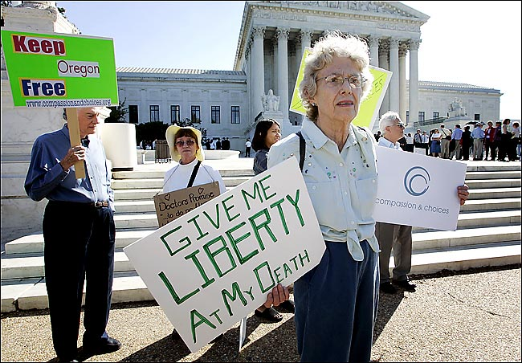
Dying with dignity?

Slide 42
The view against Euthanasia
Euthanasia is a grave violation of the law of God, since it is the deliberate and morally unacceptable killing of a human person.
Pope John Paul II: Evangelium Vitae, 1995

Slide 43

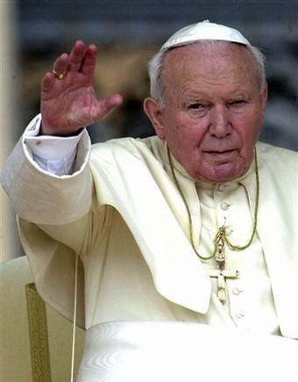


Slide 44
Main points against euthanasia
1. It is murder or suicide!
2. Euthanasia weakens society’s respect for the sanctity of life.
3. It is against religious teachings.
4. Sometimes people consent under pressure (to release their families of financial burden) but actually they don’t really want to die.

Slide 45
Questions
Should euthanasia be legalized?
If yes, can legalized euthanasia open the door for elderly people to be quietly disposed of against their will?
And may an older person feel pressured to die because they are a burden to their relatives?
What would a utilitarian say? What would Kant (a deontologist) say? What would a virtue ethicist say?

